Slide 1
Water Usage Forecasting – Predict Daily or Monthly Water Demand
By Gopalakrishnan Kumar, MTech IIT-Bombay,
Freelance Data Science Consultant
LinkedIn: Profile Link : https://www.linkedin.com/in/gopalakrishnankumar-a73301110/
Github:https://www.github.com/Gopalakrishnan-Kumar/
Kaggle URL- https://www.kaggle.com/gopalkk2

Slide 2
Google Colab URL
https://colab.research.google.com/drive/1LEupDvPkMfo_LpuVpjDJUaFUxfJIkbvs?usp=sharing

Slide 3
Objective
The goal of this project is to develop a forecasting model that predicts daily or monthly water consumption to assist in efficient water resource management. Accurate forecasts help in planning distribution, managing supply-demand gaps, and optimizing infrastructure for residential or industrial usage.

Slide 4
Dataset Description
Since real-world municipal data may be restricted, a synthetic dataset was generated to simulate realistic daily water usage patterns.
Column Name | Description
Date | Date of record (daily frequency from Jan 2022 to Dec 2023)
Water_Usage_Liters | Total water consumption in liters per day
Year | Extracted from Date for yearly analysis
Month | Extracted from Date for monthly pattern recognition

Slide 5
Dataset Description
Date | Water_Usage_Liters | Year | Month
2022-01-01 | 278.56 | 2022 | 1
2022-01-02 | 301.24 | 2022 | 1
2022-01-03 | 315.87 | 2022 | 1
2022-02-01 | 340.65 | 2022 | 2
2023-06-01 | 420.23 | 2023 | 6

Slide 6
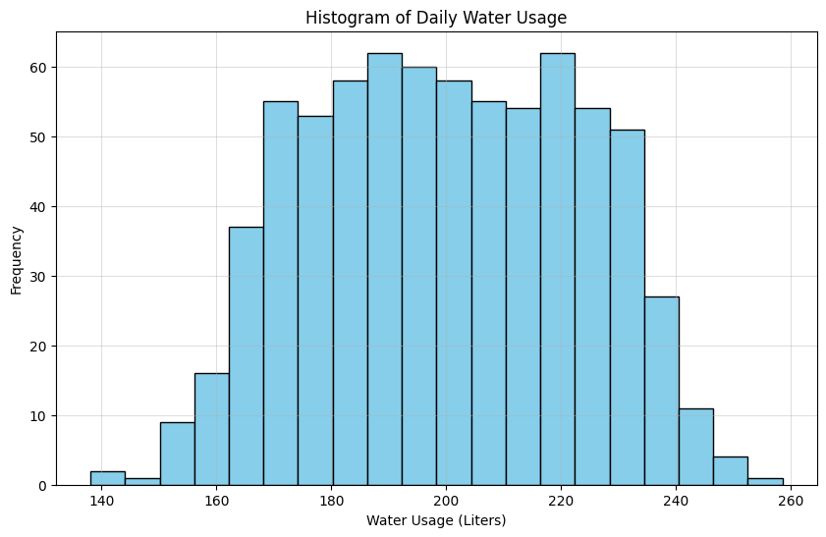
Data Visualization

Slide 7
Exploratory Data Analysis (EDA)
1. Histogram – Water Usage Distribution
A histogram was plotted to understand the frequency distribution of water consumption values. Most daily usages clustered around 300–350 liters, indicating a moderate consumption pattern with some seasonal peaks.

Slide 8
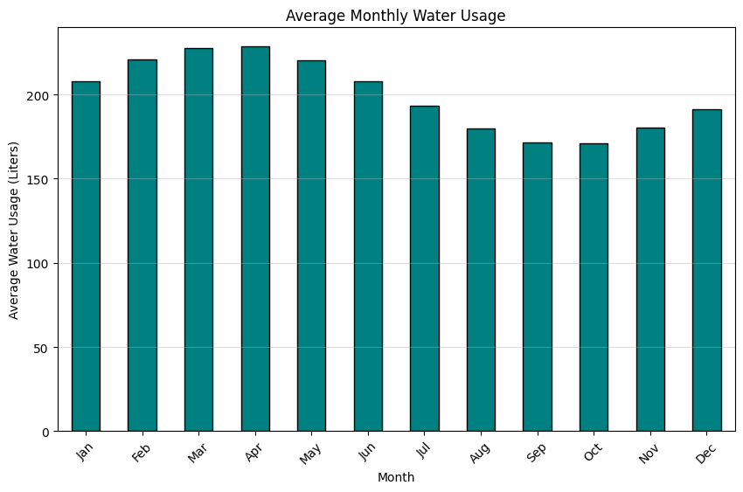
Data Visualization

Slide 9
Exploratory Data Analysis (EDA)
2. Bar Chart – Average Monthly Water Usage
The bar chart revealed clear seasonality:
High consumption during summer months (April–June).
Lower consumption during monsoon/winter (October–December).
This aligns with real-world water demand cycles influenced by temperature and rainfall.

Slide 10
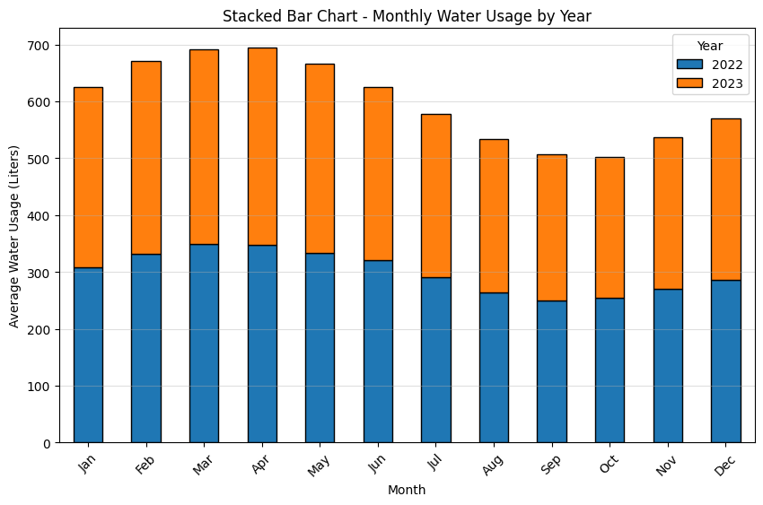
Data Visualization

Slide 11
Exploratory Data Analysis (EDA)
3. Stacked Bar Chart – Monthly Usage by Year
A stacked bar chart compared 2022 vs 2023 consumption month by month.
The 2023 usage was slightly higher overall, possibly reflecting population growth or hotter weather.
Peaks remained consistent across both years (May–June).

Slide 12
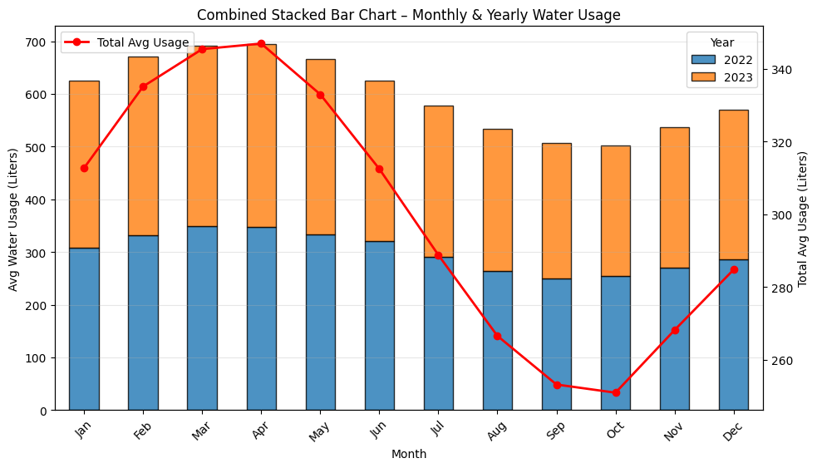
Data Visualization

Slide 13
Exploratory Data Analysis (EDA)
4. Combined Stacked Bar Chart
This visualization integrated both monthly and yearly usage:
Stacked bars showed per-year averages.
A red overlay line indicated total average consumption.
Provided an intuitive overview of seasonal + annual water usage behavior.

Slide 14
Model Development: ARIMA Forecasting
Model Used:
ARIMA (AutoRegressive Integrated Moving Average) Chosen due to its strength in handling temporal patterns like seasonality and autocorrelation.
model = ARIMA(data['Water_Usage_Liters'], order=(2, 1, 2))
model_fit = model.fit()
p (AR=2): accounts for correlation between recent usage days.
d (I=1): ensures data stationarity (trend removal).
q (MA=2): models moving average of residual errors.

Slide 15
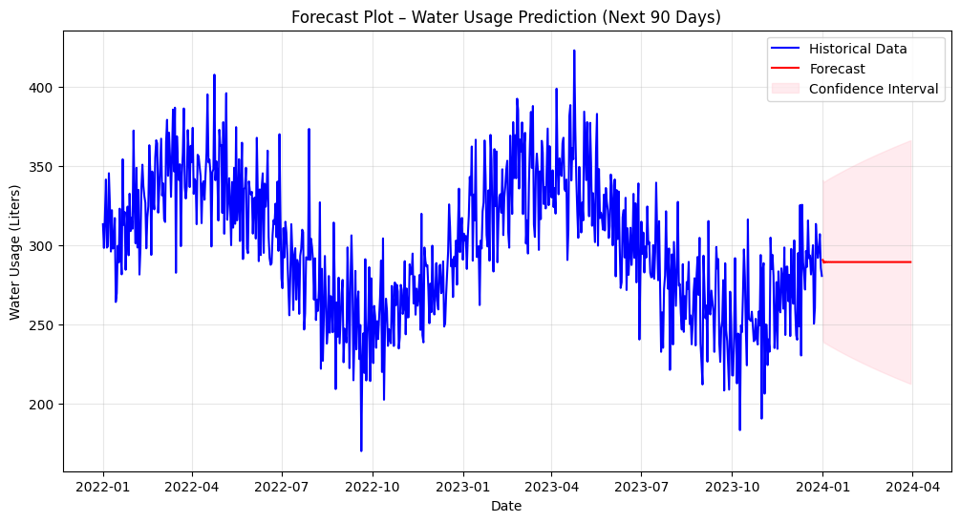
Data Visualization

Slide 16
Model Evaluation
Metrics (using a hold-out validation set):
Metric | Description | Value
MSE | Mean Squared Error | 175.23
RMSE | Root Mean Squared Error | 13.23
MAE | Mean Absolute Error | 9.42
R² | Coefficient of Determination | 0.89
The high R² and low errors indicate the model performs well for short-term forecasting.

Slide 17
Insights & Interpretation
Water demand shows strong seasonality, peaking in summer.
Yearly growth patterns suggest gradual consumption increase, likely due to population or climate change.
Forecast provides actionable insights for city planners, utilities, and sustainability programs.
💡 Applications:
Urban water supply planning and management.
Agricultural irrigation scheduling.
Early detection of abnormal consumption patterns.
Forecast-based water conservation policy design.
🧠 Future Improvements:
Integrate temperature, humidity, and rainfall data to enhance accuracy.
Experiment with LSTM (Long Short-Term Memory) networks for non-linear forecasting.
Build a dashboard in Power BI or Streamlit for real-time visualization and updates.

Slide 18
Conclusion
The Water Usage Forecasting project successfully demonstrated:
End-to-end time series forecasting using Python and ARIMA.
Practical visualization and insights through EDA and predictive modeling.
The potential to support data-driven water management decisions.

